Slide 1
Active Learning Twitter Analytics
BDA2
PC 53 Saksham Shrimali
PD Shubham Mishra

Slide 2
Abstract
Twitter is now the third most popular social network, behind Facebook and MySpace. Twitter plays a major role when social media marketing is discussed. When a project for social media marketing approach is made, twitter is the first social media site that comes to mind. It is mandatory to dedicate time to research about the competitors and audiences behavior. It is mandatory to monitor twitter analytics. Twitter analytics are mentioned to be the insights about the conditions of marketing messages. The user can obtain and access information about the statistics, insights into social media marketing and its performance.
One of the key pieces of information you can – and should – get from twitter data is the demographic variables of your audience. Once you understand your audience’s economic background, education, nationality, age, gender, language and so on, you should already have some information on your followers’ needs and wishes. To enhance engagement, find out when your customers are online, and post during those specific time windows. To be able to optimize your content for higher engagement, you need to make an educated guess about what made a particular tweet stand out among thousands of other tweets that showed up on your followers’ feeds at that very second!
In short , Twitter Analytics tools can help in the quest of giving your twitter data a purpose and turning it into actionable insights that you can use to make well-thought business decisions and come up with a competitive marketing strategy.

Slide 3
Twitter Analytics Tools Used
1. Tweepsmap
Tweepsmap is an excellent Twitter tool for both analyzing and visualizing your Twitter network.
As it’s name suggests it does this by showing you how your followers are distributed on a map, in terms of percentages.
2. Keyhole
Keyhole is the go-to tool for individuals and companies looking to understand what topics and types of posts attract their audience’s attention, and track when most of the relevant conversations take place.

Slide 4
Advantages of “ Tweepsmap “
Mapping:
This is to map followers worldwide, to a city level. Influencers and followers per location can be discovered for easy campaigning.
Intelligent publishing:
Publishing is made straight forward specific to the followers’ interest, at best time and more.
Analyze influencers and competitors:
This tool assists in the comprehensive analysis of accounts even your competitors.
Best time to tweet:
This is an important feature in tweetsmap as it shows the best time to be tweeted when the followers are online and also on amplification potential for tweets.
Tweets to be sent automatically:
This feature helps to send tweets on a specific day, the number of tweets at fixed frequencies. Tweets can also be edited.
Growth and decline:
The decline and growth by region can be known. It could be monthly, weekly, or customized too.

Slide 5
Advantages of Keyhole
Monitor and manage social conversations and brand sentiment
Find trending topics
Track and aggregate events and campaign data
Research live and historical data
Analyse your competitors
Easily share in-depth reports with your team

Slide 6
Details of Dataset
Using Tweepsmap,we did real time analysis of Twitter account.
Using Keyhole,we did analysis based on keywords and hashtags.
We also extracted data using Monkeylearn Api ,we can use the extracted text for analysis purpose using Keyhole.

Slide 7
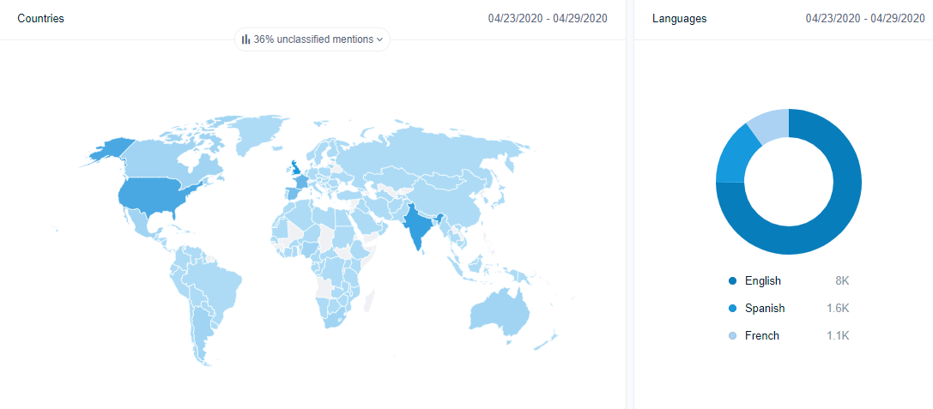
Visualization using Tweepsmap
Observation:This visualized data displays the country wise tweets on my twitter account means it shows the number of tweets from various countries .

Slide 8
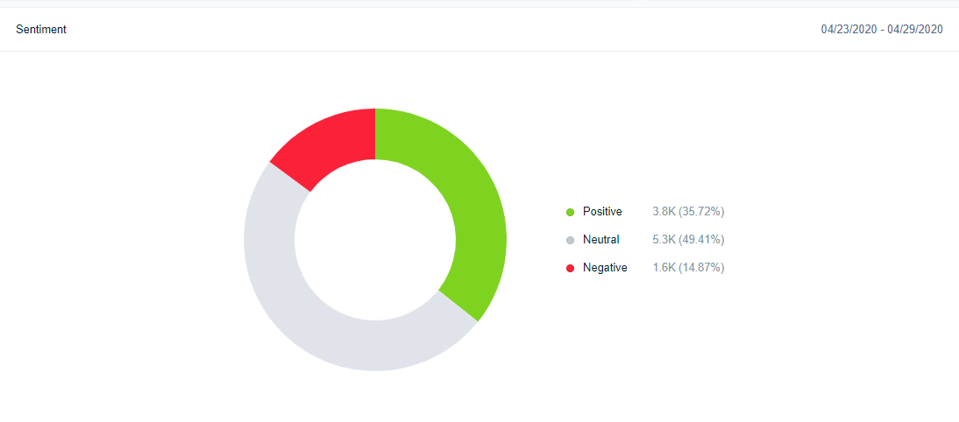
Observation:Sentiment analysis, also known as opinion mining, opinion extraction, sentiment mining or subjectivity analysis, is the process of analyzing if a piece of online writing (social media mentions, blog posts, news sites, or any other piece) expresses positive, negative, or neutral attitude.

Slide 9
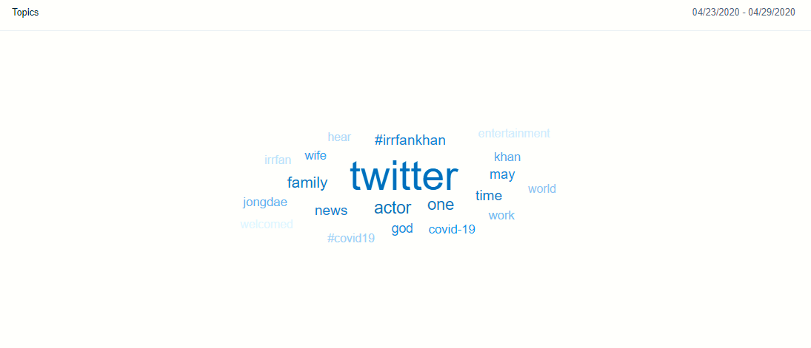
Observation:Text analysis of twitter account,dispaying popular hashtags and keywords.

Slide 10
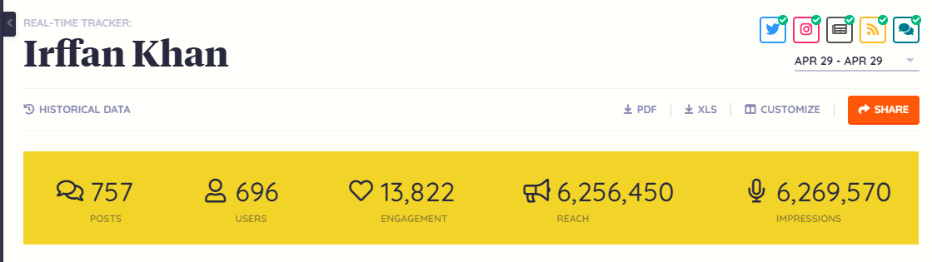
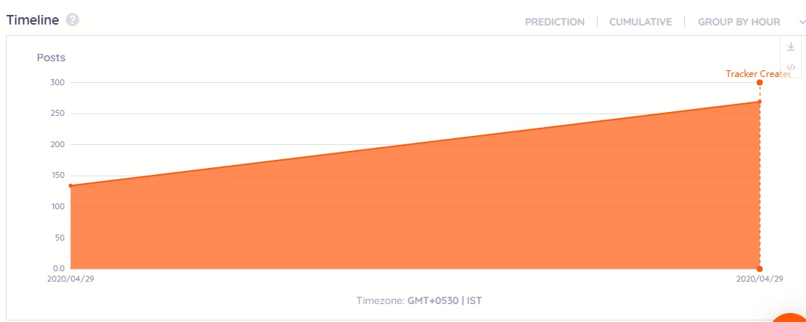
Visualization using Keyhole
Observation:This displays the number of posts vs Date/Time graph,it displays the total number of posts on a particular day along with time.We can set the range for dates also.In this we used #IrffanKhan as a keyword for analysis. .

Slide 11
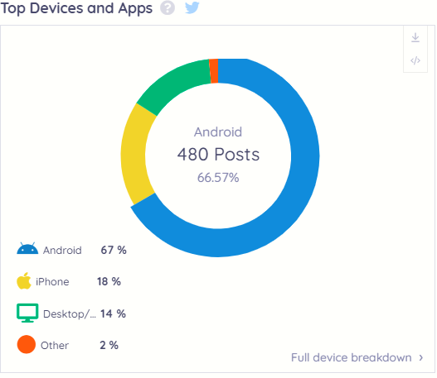
Observation:This displays the number of posts made from various devices based on keywords and hashtags.

Slide 12
Conclusion

Slide 13
References
https://www.digitalnuisance.com/twitter-analytics-tools/
https://twittertoolsbook.com/10-awesome-twitter-analytics-visualization-tools/
https://keyhole.co/blog/twitter-analytics-definitive-guide/
For detailed visualized report refer:
>https://web.mention.com/#dashboardPublic/d/1042765_UVAQ3teRac93wthPju41kpq05dU9wjkqCM9etDU89iK6NNMy9yY8FymGuqVvSPTq/367021/nO93gKHr2pGnsjpFhOU7FkfGoHnJTczK
>https://keyhole.co/hashtag-tracking/dashboard/4ceY18/Irffan-Khan?page=1&perPage=25

Slide 14
Thank You

